Slide 1

A compact injection-locked UV laser system for quantum information processing
Nikolay Videnov
Quantum Information with Trapped Ions (QITI) Group

Slide 2
Talk outline
Problem we are addressing
What is uv used for
Simple requirements
A survey of possible solutions with drawbacks
What is injection locking
Surface level
Minimal theory
Demos of some form ? Graphs ?
Our design
Cooling
Challenges
Results?

Slide 3
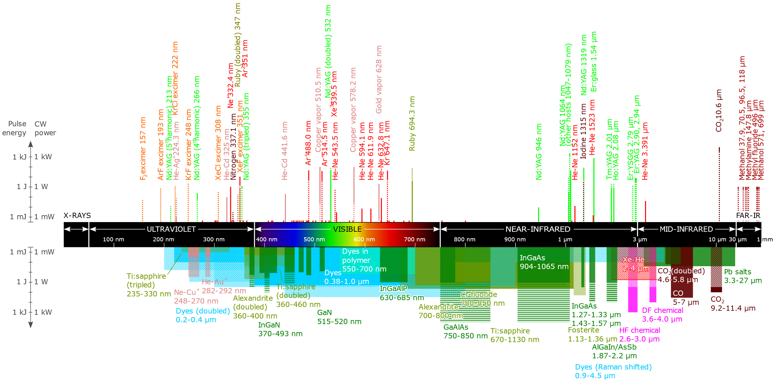
UV lasers
Uses
Getting UV light
Frequency doubling Ti:sapph
expensive
Noisy?

Slide 4
Injection Locking
Borad strokes injection locking
Alder equations, amplifier filter model?

Slide 5
Physically realizing Injection Locking
Cooling considerations
Compactness?

Slide 6
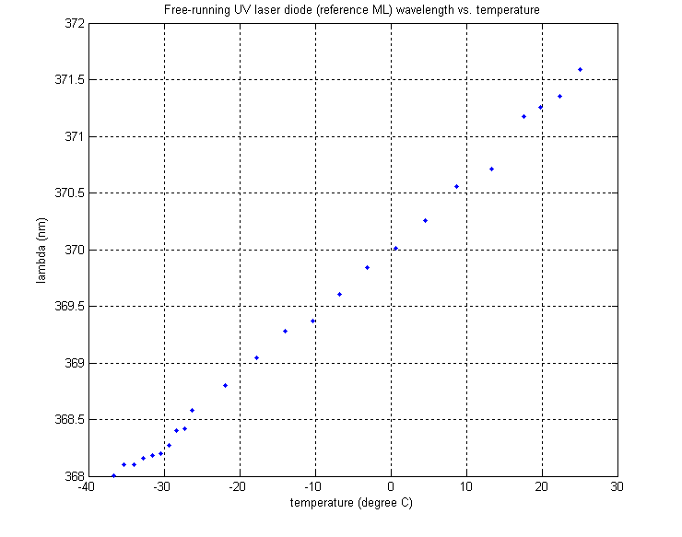
Diode Selection
Locking only happens around the free running oscillation frequency of the diode.
Need a laser diode around 369nm
The closest commercially available diode can be frequency selected to ~371nm*
*Nichia NDU4116 (370-380nm)

Slide 7
Cooling Laser Diode
40°C below lab temperature
Achievable with Thermoelectric Coolers (Peltier eliments)
Dew point of water in lab is around 12°C
Condensation and frost will form on the diode
Sealed laser enclosure for cooling
Electrical and optical feedthrough
Dry air inlet/outlet
Good thermal conduction

Slide 8
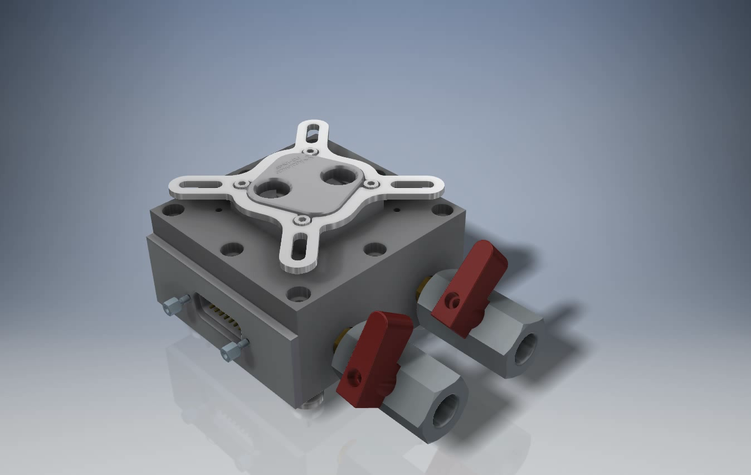

Slide 9
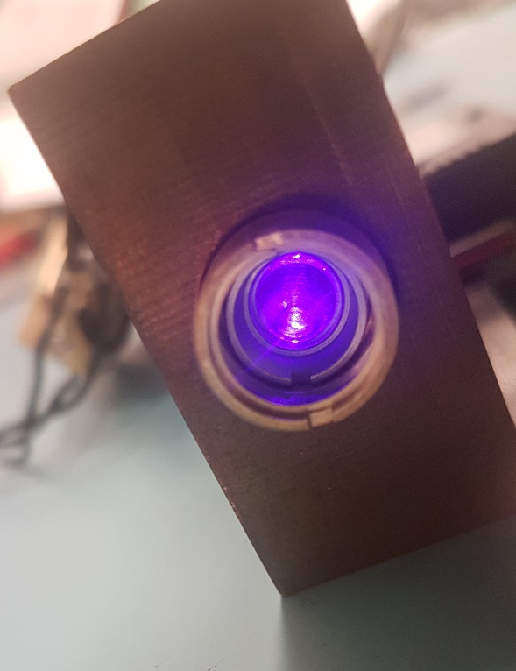
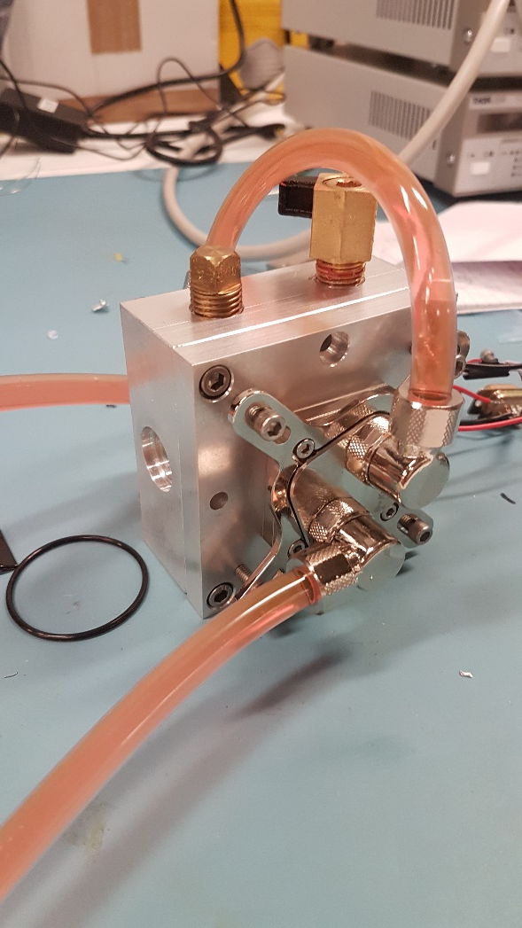
Implementation

Slide 10
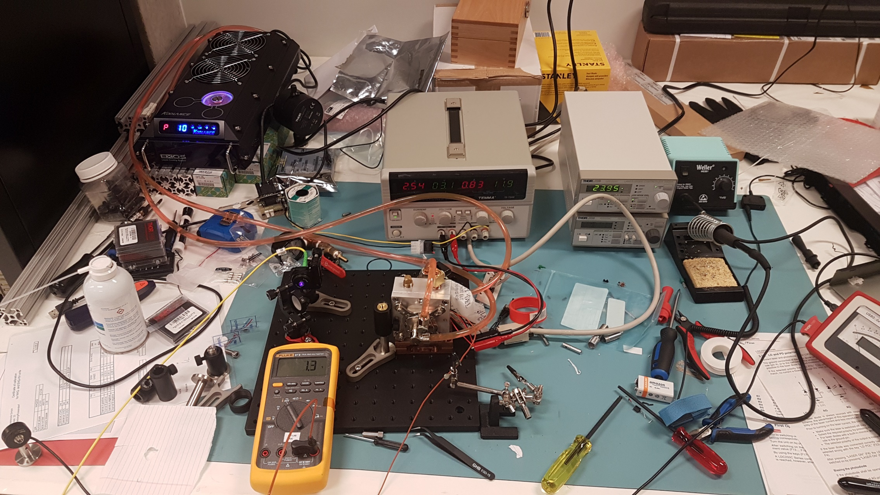
Results

Slide 11
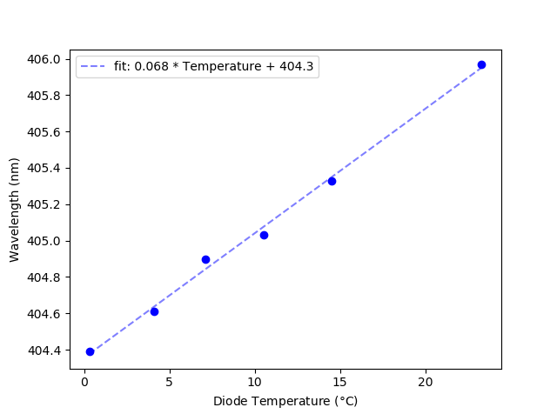
Results

Slide 12
Conclusion/Outlook
Injection lock?

Slide 13








Fereshteh
Gilbert
Nikhil
Rajibul
Nikolay
Roland
Sainath
THANK YOU

